Slide 1

Learning Attributed Subgraph Matching
Yanxi Lu
Supervisor: Dr. Qing Wang

Slide 2
Outline
Introduction and problem definition
Existing methods and Motivation
Methodology
Experiments and Results
Future Work
2

Slide 3
Graph
Nodes {1, 2, 3}
1
2
3
Edges {(1, 2),
(2, 3),
(1, 3)}
Enough information for real tasks?
3

Slide 4
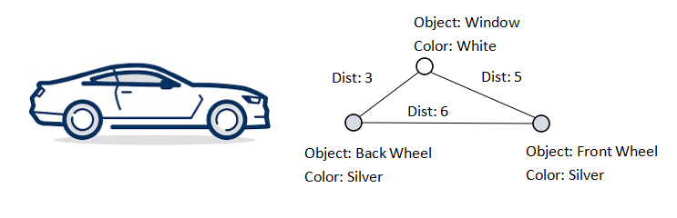
Attributed graphs
Richer graph representations
Figure 1: Example Attributted Graph
3

Slide 5
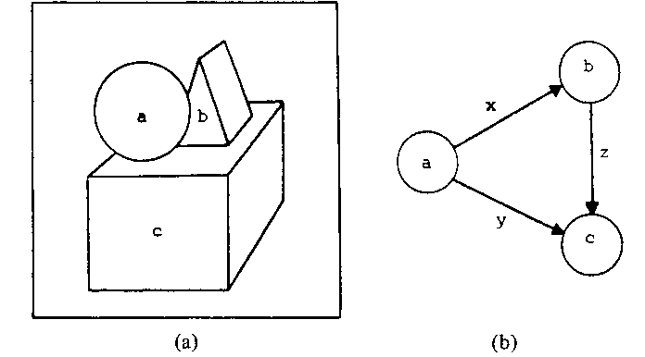
Application of Attributed Graph
- Pattern representation in images
Figure 2: Attributed graph representation of image features^{[2]}
3

Slide 6
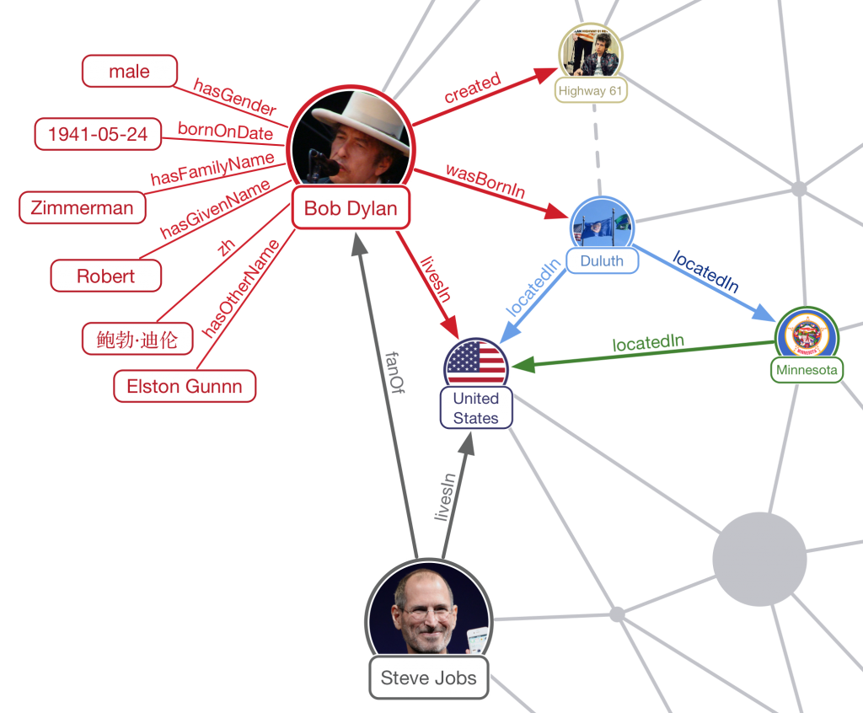
Application of Attributed Graph
Social system
Figure 3: Attributed graph representation of social system^{[1]}
3

Slide 7


Attributed Graph Matching
Given: 2 attributed graphs
Find: pairwise matching of the nodes across graphs
NP-complete
Figure 4: attributed graph matching example^{[3]}

Slide 8
Attributed Graph Matching
Applications
Computer Vision
- Object recoginition
Medicine
- Diagnostics
Biology
- Biometric identification
NLP
- Document matching
Recommender System
...
3

Slide 9
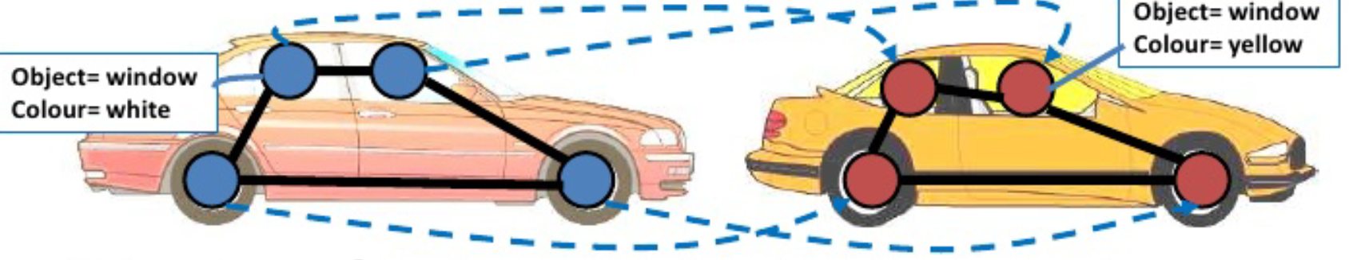
Inexact Attributed graph Matching
Observation: exact matches don't always exist, find the best match
Figure 5: Inexact attributed graph matching example^{[4]}.
4

Slide 10
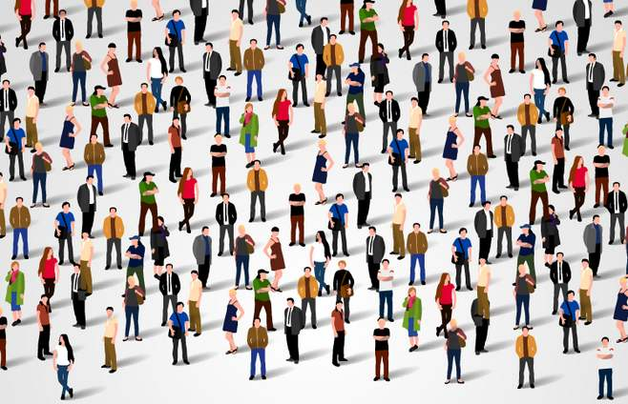
Attributed subgraph Matching
Find best match among in the graph(both structural and attibute)
Figure 6: Crowd^{[5]}.
4

Slide 11
Problem Definition
Given: 2 attributed graphs G and G', as well as a (query) subgraph g from G
Find: The best matching subgraph in G'
NP-hard
Gap in existing methods
5

Slide 12
Existing Approaches
Possible to enumerate all the candidate subgraphs, but inpractical.
Existing approaches are all approximations
5

Slide 13
Existing Approaches
Index-based
1. Develop index functions for nodes to capture node information.
2. Apply approximation algorithms to find the optimal matching.
pros: index usually intuitive, e.g. node neighbourhood
cons: Require handcraft index function
Do not generalize well
5

Slide 14
Existing Approaches
Graph kernels
ML kernel methods applied on graphs.
Measures graph similarity.
stackable
Subgraph matching kernel, Optimal Assignment(OA) kernel
pros: many available kernels
cons: handcraft kernel function
5

Slide 15
Existing Approaches
Substructure-similarity based
1. Compute similarity for every pairs of substructures across graphs
2. Matching based on substructure similarity
pros: Can use ML to learn similarity measure
cons: Prone to error
Hard to reason about matching process
Space complexity
5

Slide 16
Our model
Purpose: To mitigate the problems in current approaches
Use neural network to learn node representations and similarity
considering the query subgraph as a whole
11

Slide 17
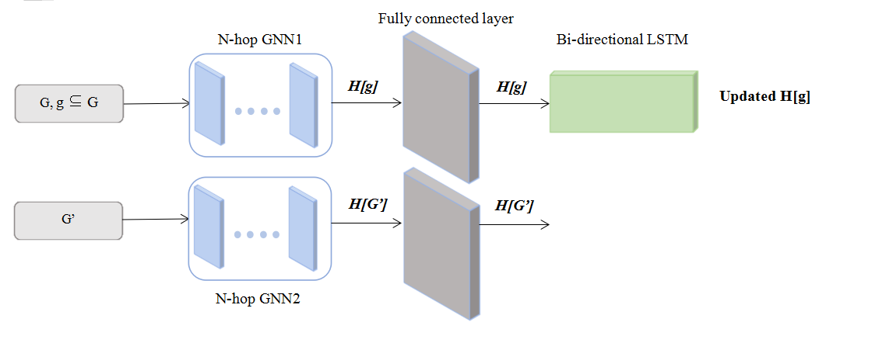
Our model
An overview
Figure 7: Model Overview. H(g) is the set of node embedding for nodes in g
11

Slide 18
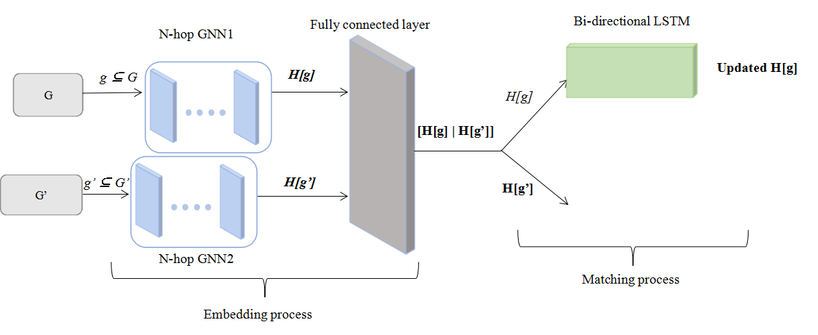
Training stage
Novel idea: Train with pairs of matching subgraphs
Figure 8: Model for the training stage.
11

Slide 19
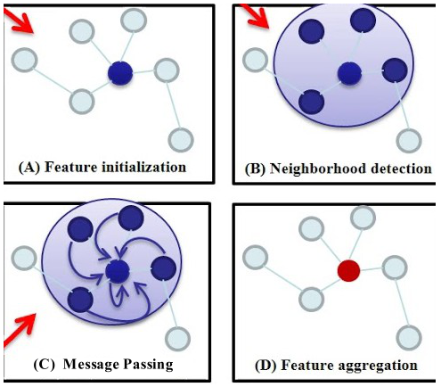
Embedding process
Graph Neural Network(GNN)
Figure 9: An illustration of 1-degree (hop) graph neural network^{[6]}. The network works based on the principle of message passing.
7

Slide 20
Embedding process
Fully connected layer
- Combine the separate node embeddings, learn two graphs jointly
Embedding Loss
- L_{e} = difference in embeddings between graphs in the training pair
7

Slide 21
Matching process
Inspired by NLP
In sentences, words are closely correlated.
Same for nodes in the same graph
Novel idea: Treat graphs as sequence of nodes
Learn the sequence
LSTM: capture long-short term dependencies
15

Slide 22
Matching process
How to sequence the nodes?
- random sequence
Bi-directional LSTM learns dependencies in both directions
17

Slide 23
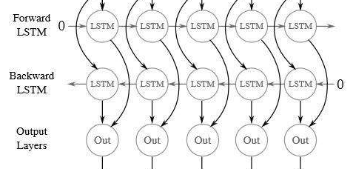
Matching process
Only g is input
Bi-directional LSTM(BiLSTM)
N1
N2
N3
N4
N5
Figure 10: 1 layer Bi-directional LSTM used in the model^{.[7]} The input is one subgraph in each pair.
16

Slide 24
Matching process
Finding the best match
- look for closest neighbour for each node using its embedding
Matching Loss:
- Let g'' be the best matching found,
L_{M} = difference in distance matrix between query graph g and g''.
Total loss:
L_{E} + γL_{M} where γ is a hyperparameter, default is 0.5.
18

Slide 25
Testing stage
Only have the query subgraph
11

Slide 26
Experiments
Three datasets:
1. Synthetic dataset
2. Cora
3. MovieLens
Three early (~2010) baselines:
1. TALE(index-based)
2. Optimal Assignment(OA) kernel
3. LG method(substructure-similarity based).
Measure:
1. Accuracy
2. Precision
12

Slide 27
Synthetic Dataset
Randomly generate 200 pairs of matching subgraphs of size 3, 4, 5 with attributes Color ∈ {R, G, B}
Each pair obtained by randomly generating one and get the other with small modifications
Aggregate the pairs to form the large graphs
12

Slide 28
Cora Dataset
Classification dataset
Entries: 2708 machine learning papers
Each has 1433 features denoting the presence of 1433 keywords
Class: type of paper
Randomly extract 200 pairs of matching subgraphs of size 3, 4, 5 using a greedy approach.
12

Slide 29
MovieLens Dataset
Dataset recording movie rating
Entries: movies
Each has 22 features denoting its information and rating
Randomly extract 200 pairs of matching subgraphs of size 3, 4, 5.
12

Slide 30
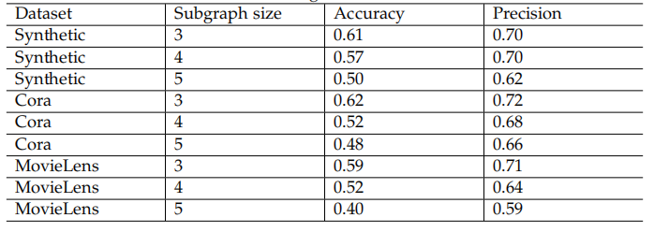
Experimental Result
Result for our model on different datasets, taking average of 10 runs
Results: Ok but not exceptional
For different datasets, scalablility changes
12

Slide 31
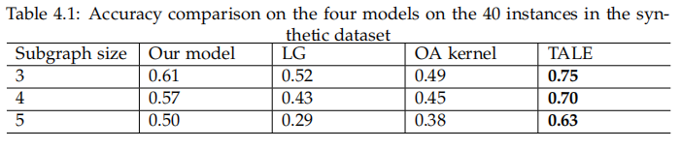
Comparison with baselines
Synthetic dataset: Simple attributes, Little number of nodes
Second among the four methods
19

Slide 32
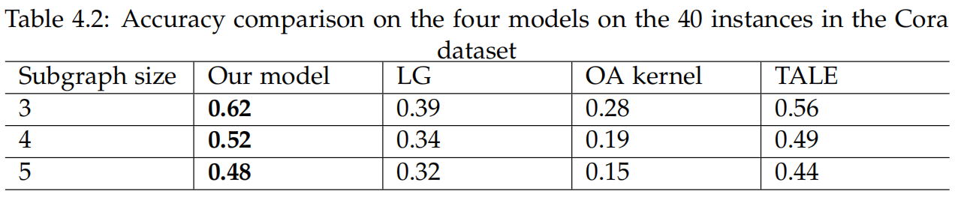
Comparison with baselines
Cora dataset: Very complex attributes, Large number of nodes
The best model in this set of experiment.
19

Slide 33
Result analysis
For a model which introduces novel ideas, achieved moderate performance
Performance problem-dependent, probably attributed to the loss function
Some error may be resulted by the dataset processing step(the matching pairs found not accurate)
Naive graph sequencing process
19

Slide 34
Future Work
Compare with more recent baselines
Try other models for processing sequential data
Try embedding into other spaces
Include edge attributes
Involve heterogeneous graphs
20

Slide 35
Thank you!
21

Slide 36
References
[1]: Image from: https://medium.com/@brkyataman/knowledge-graph-and-youtube-29d259fd3dc1
[2]: Image from: A. Wong and M. You, Entropy and Distance of Random Graphs with Applications to Structural Pattern Recognition
[3]: Image from: https://www.kissclipart.com/silhouette-person-thinking-clipart-silhouette-clip-10cl2p/
[4]: Image from: https://www.slideshare.net/mobile/raul_A/attributed-graph-matching-of-planar-graphs
[5]: Image from: https://huaban.com/pins/1112150236/
[6]. Image from: Jun Wu, Jingrui He, Jiejun Xu, https://www.kdd.org/kdd2019/
[7]. Image from: https://www.sohu.com/a/283978749_717210
22

